Slide 1

Gaussian Process Occupancy Maps
RBE 550: Motion Planning
Paper Review
Authors: S. Callaghan and F. Ramos
Presenter: Sapan Agrawal

Slide 2
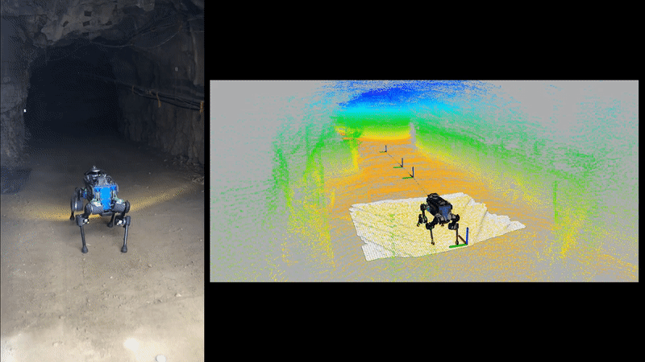
ANYmal Robot at DARPA SubT STIX
Source: https://www.youtube.com/watch?v=6eB-2Rzojh4
Notes:
This is the Darpa Subterranean Challenge where the robot has to map and navigate in underground environment.
The robot has to plan a feasible path from it current position to the goal while avoiding the obstacles.
perceive the environment using various sensors: lidar range sensor, camera or depth sensor, generally in form of point cloud as we see in the video.
With this information about the environment, we want to know the location of the obstacles and where the robot can move safely.

Slide 3
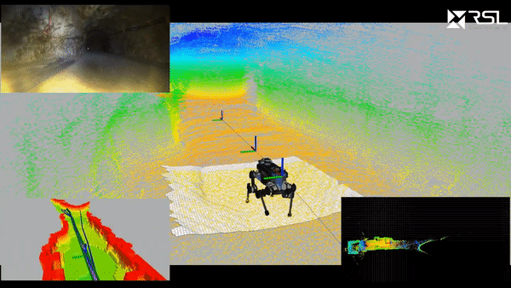
What is Occupancy Map?
A representation map of the environment as an evenly spaced Random Variable each representing presence of obstacle in that location.
Notes:
So, this representation map which classifies the region as either occupied or freespace is known as the Occupancy Map.
As we see in the video the occupancy map is created on the left side using the depth information from lidar sensor. The walls are classified as obstacles in the red while the free space is in green.

Slide 4
Problem with Occupancy grid?
Notes:
What’s the problem in using the Occupancy grid map?

Slide 5
Problem with Occupancy grid?
Independence relationship between the cells
Notes:
What’s the problem in using the Occupancy grid map?
Probability of cell being occupied depends only on laser beam and not influenced by neighboring cells. However, we know that due to physical structure of the objects spatial dependency exists.

Slide 6
Problem with Occupancy grid?
Independence relationship between the cells
Inaccurate results in regions of uncertainty (occluded region, sensor noise)
Notes:
What’s the problem in using the Occupancy grid map?
Probability of cell being occupied depends only on laser beam and not influenced by neighboring cells. However, we know that due to physical structure of the objects spatial dependency exists.
Other drawbacks of using traditional Occupancy map are Discretization Error and Large Memory .
If discretization is very coarse, it may misrepresent a free space as occupied.
On the other hand, if the discretization in fine, it requires more memory and computation time.

Slide 7
Problem with Occupancy grid?
Independence relationship between the cells
Inaccurate results in regions of uncertainty (occluded region, sensor noise)
Discretization Error
Notes:
Second is the discretization error.
If discretization is very coarse, it may misrepresent a free space as occupied.

Slide 8
Problem with Occupancy grid?
Independence relationship between the cells
Inaccurate results in regions of uncertainty (occluded region, sensor noise)
Discretization Error
Coarse discretization can misrepresent a cell
Notes:
Second is the discretization error.
If discretization is very coarse, it may misrepresent a free space as occupied.

Slide 9
Problem with Occupancy grid?
Independence relationship between the cells
Inaccurate results in regions of uncertainty (occluded region, sensor noise)
Discretization Error
Coarse discretization can misrepresent a cell
Large memory requirement
Notes:
On the other hand, if the discretization in fine, it requires more memory and computation time.

Slide 10
Problem with Occupancy grid?
Independence relationship between the cells
Inaccurate results in regions of uncertainty (occluded region, sensor noise)
Discretization Error
Coarse discretization can misrepresent a cell
Large memory requirement
Fine discretization will be computationally expensive and require more memory.
Notes:
On the other hand, if the discretization in fine, it requires more memory and computation time.

Slide 11
Why Gaussian Process?
Uses continuous, non-linear, non-parametric function to represent map
Notes:
Learn the relationship between the neighboring cells. So, if the sensor data is noisy, it classifies the cells correctly due to dependency.
Non- parametric means there is no explicit input-output function.

Slide 12
Why Gaussian Process?
Uses continuous, non-linear, non-parametric function to represent map
predict dependency between the neighboring cells.
Notes:
Learn the relationship between the neighboring cells. So, if the sensor data is noisy, it classifies the cells correctly due to dependency.
Non- parametric means there is no explicit input-output function.

Slide 13
Why Gaussian Process?
Uses continuous, non-linear, non-parametric function to represent map
predict dependency between the neighboring cells.
Robust to noise and sparse data
Notes:
2) Any-time Algorithm: algorithms that can return a valid solution to a problem even if it is interrupted before it ends. E.g. Newton’s Gradient descent method. Thus, course resolution maps can be generated quickly to generate the path.

Slide 14
Why Gaussian Process?
Uses continuous, non-linear, non-parametric function to represent map
predict dependency between the neighboring cells.
Robust to noise and sparse data
Any-time Algorithm
Notes:
2) Any-time Algorithm: algorithms that can return a valid solution to a problem even if it is interrupted before it ends. E.g. Newton’s Gradient descent method. Thus, course resolution maps can be generated quickly to generate the path.

Slide 15
Why Gaussian Process?
Uses continuous, non-linear, non-parametric function to represent map
predict dependency between the neighboring cells.
Robust to noise and sparse data
Any-time Algorithm
Can get both coarse and fine maps.
Notes:
2) Any-time Algorithm: algorithms that can return a valid solution to a problem even if it is interrupted before it ends. E.g. Newton’s Gradient descent method. Thus, course resolution maps can be generated quickly to generate the path.

Slide 16
Why Gaussian Process?
Uses continuous, non-linear, non-parametric function to represent map
predict dependency between the neighboring cells.
Robust to noise and sparse data
Any-time Algorithm
Can get both coarse and fine maps.
Variance plot can be used to highlight unexplored region
Notes:
Learn the relationship between the neighboring cells. So, if the sensor data is noisy, it classifies the cells correctly due to dependency.
Non- parametric means there is no explicit input-output function.
2) Any-time Algorithm: algorithms that can return a valid solution to a problem even if it is interrupted before it ends. E.g. Newton’s Gradient descent method. Thus, course resolution maps can be generated quickly to generate the path.
3) Additional feature is that variance can be used to find the unexplored regions.

Slide 17
Why Gaussian Process?
Uses continuous, non-linear, non-parametric function to represent map
predict dependency between the neighboring cells.
Robust to noise and sparse data
Any-time Algorithm
Can get both coarse and fine maps.
Variance plot can be used to highlight unexplored region
Additional benefit
Notes:
Learn the relationship between the neighboring cells. So, if the sensor data is noisy, it classifies the cells correctly due to dependency.
Non- parametric means there is no explicit input-output function.
2) Any-time Algorithm: algorithms that can return a valid solution to a problem even if it is interrupted before it ends. E.g. Newton’s Gradient descent method. Thus, course resolution maps can be generated quickly to generate the path.
3) Additional feature is that variance can be used to find the unexplored regions.

Slide 18
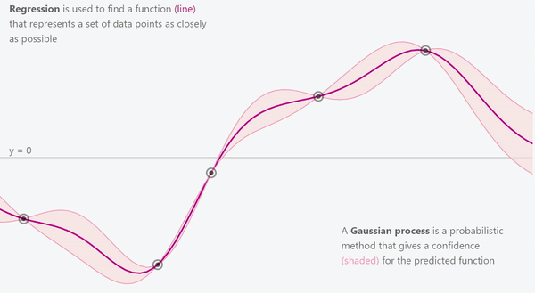
What is Gaussian Process?
Source: https://distill.pub/2019/visual-exploration-gaussian-processes/
Notes:
Gaussian Process is a tool in Machine Learning that allows us to make predictions based on prior observed data.
So it can be used for Fitting a function (regression problem), classification and clustering.
For a given training points there are infinitely many functions that can fit the data.
GP assigns the probability to these functions.

Slide 19
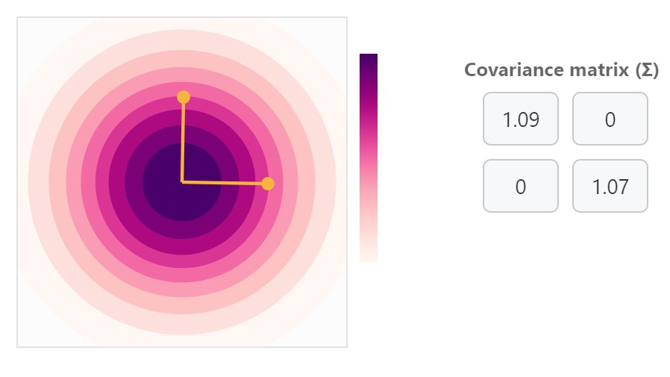
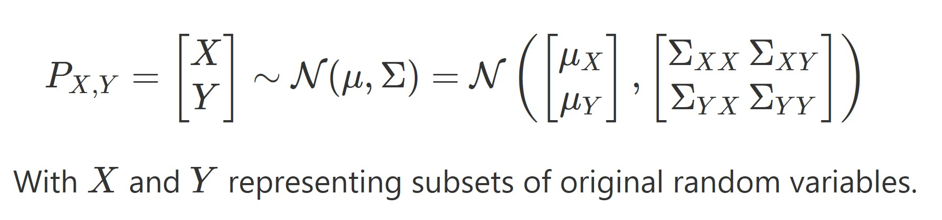
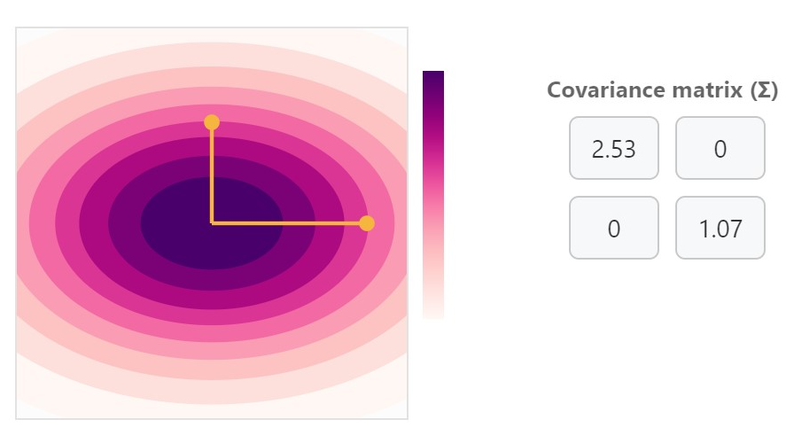
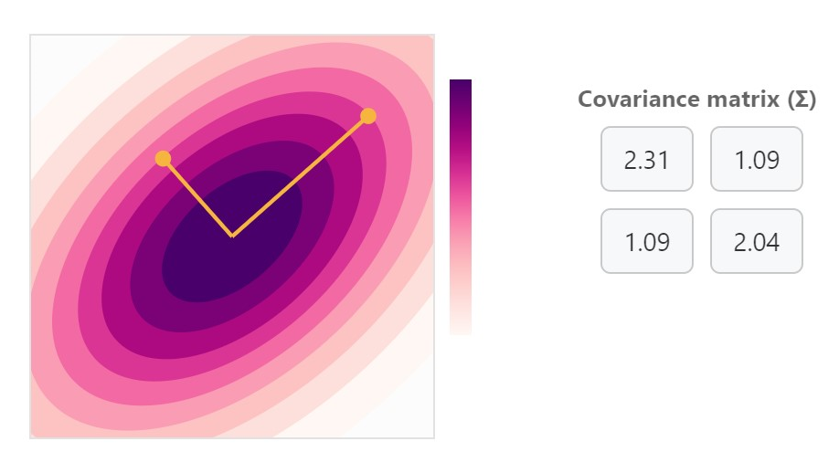
Gaussian Process
Notes:
So a gaussian distribution is defined by its mean and covariance.
For a 2 dim gaussian distribution the covariance is a 2x2 matrix.
In the figures we see how the covariance matrix affect the shape of the gaussian distribution.

Slide 20

Gaussian Process
Notes:
Higher value of XX position of Covariance matrix means higher variance in the X direction.

Slide 21


Gaussian Process
Notes:
The XY position in the Covariance matrix (in figure 3) tells us how strongly the X and Y random variables are corelated to each other.
So in figures 1 and 2 the X and Y Random variables are independent of each other.

Slide 22
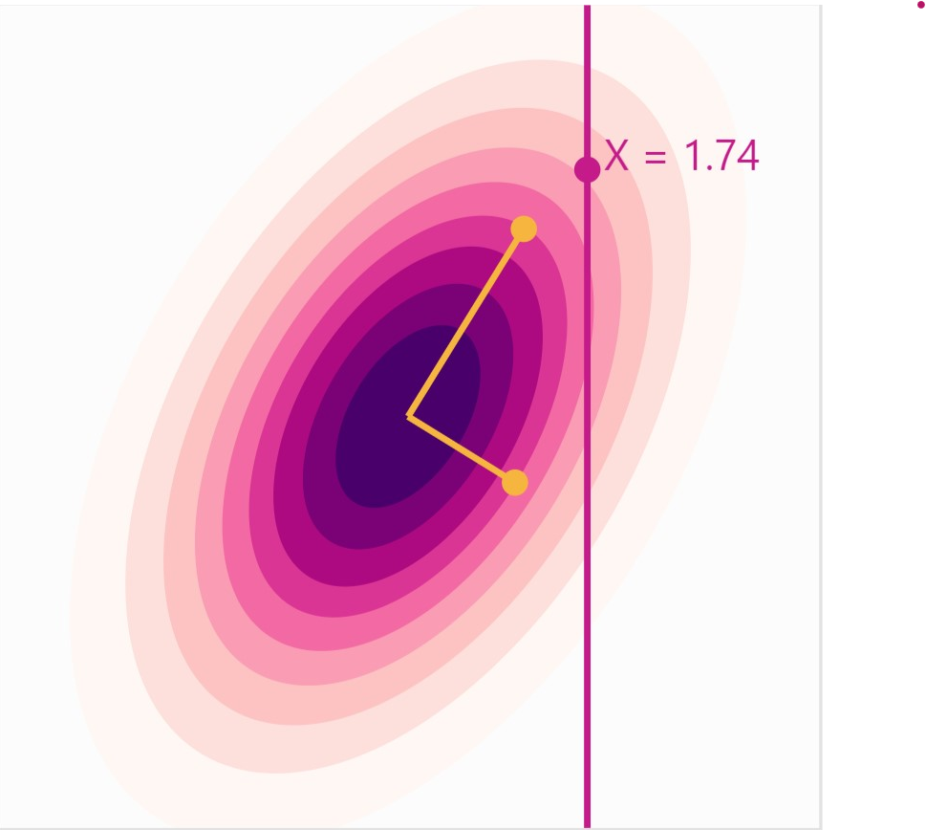
Gaussian Process
Notes:
So lets go back to the corelated guassian distribution.
So, someone asks us given precisely value of X to be 1.74 whats the value of Y?
It looks like y can take many values.

Slide 23

Gaussian Process
Notes:
It comes out to be Gaussian distribution.

Slide 24
Gaussian Process
Conditioning
Gives the correlation between variables.
Notes:
This operation is known as conditioning.
It basically gives us the probability of one variable depending on another variable.

Slide 25
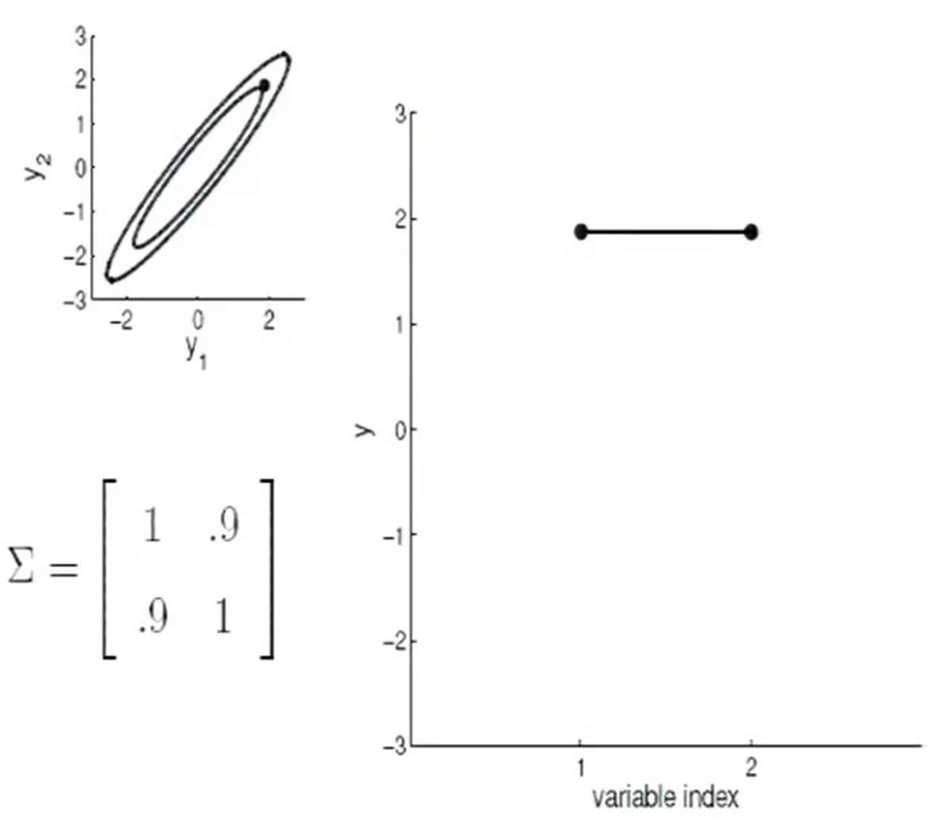
Gaussian Process
Source: https://www.youtube.com/watch?v=Jv25sg-IYHU
Notes:
Suppose now for the corelated gaussian distribution, I place my variables along X axis and their value along Y.
We get new representation. So here both the variables y1 and y2 have the same value of 2.

Slide 26
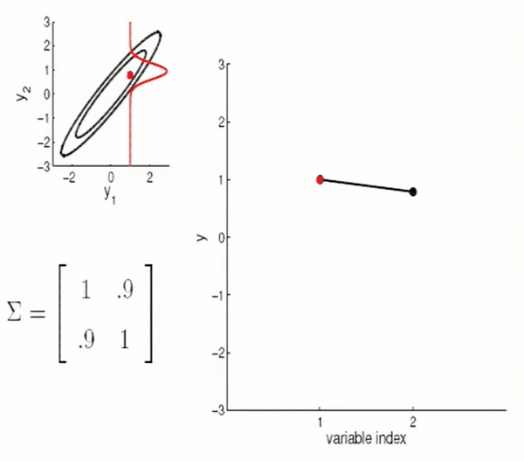
Gaussian Process
Notes:
Now if we fix the variable 1 and sample variable 2 from the conditioned distribution.
The line in the figure just wiggles at the pivot.

Slide 27
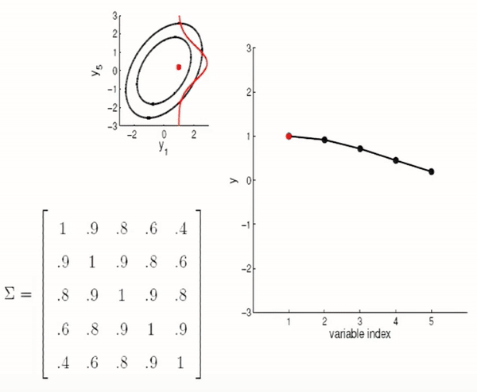
Gaussian Process
Notes:
So extending to the higher dimension, we get this.

Slide 28
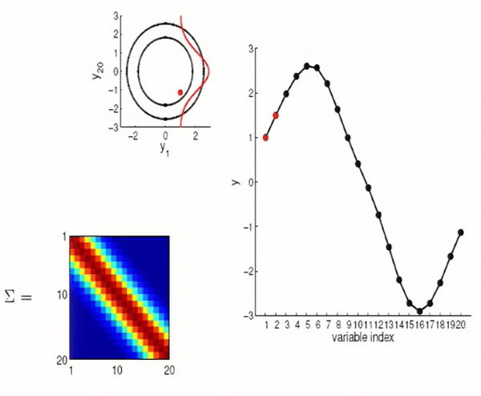
Gaussian Process
Notes:
Representing the Covariance matrix in the colormap for higher dimensions.

Slide 29
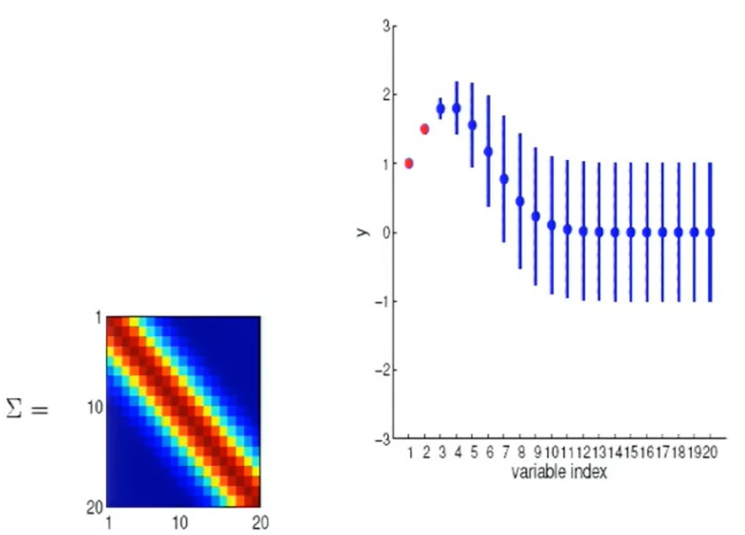
Gaussian Process
Notes:
So if we average over all the random sample, we get this nice looking non-linear regression which goes through the points that we might observe. So given y1 and y2, by learning enough I can predict the values of the variables.

Slide 30
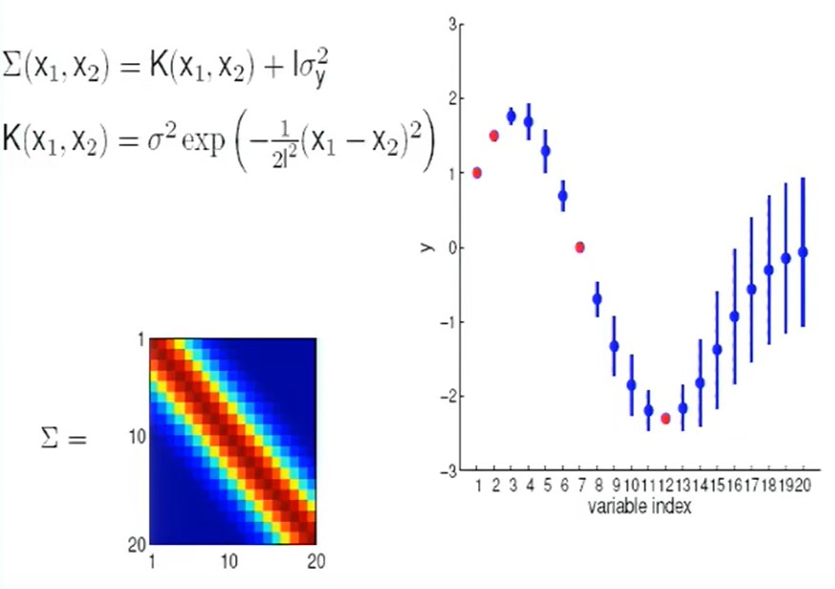
Gaussian Process
Notes:
So how do we come up with this powerful covariance matrix.
The answer is the covariance function also commonly known as kernel.
So basically this linear kernel over here, has strong correlation between the variables which are close to each other.
And the dependency decreases as they go away from each other.

Slide 31
What is Gaussian Process?
Source: https://distill.pub/2019/visual-exploration-gaussian-processes/
Notes:
Gaussian Process is a tool in Machine Learning that allows us to make predictions based on prior observed data.
So it can be used for Fitting a function (regression problem), classification and clustering.

Slide 32
What is Gaussian Process?
Our Problem:
To find a non-linear function that can predict the occupancy of a region given the sensor information and prior knowledge.
Notes:
So our problem is:
To find a non-linear function that can predict the occupancy of a region sensor information and prior knowledge i.e. location and occupancy of the training data

Slide 33
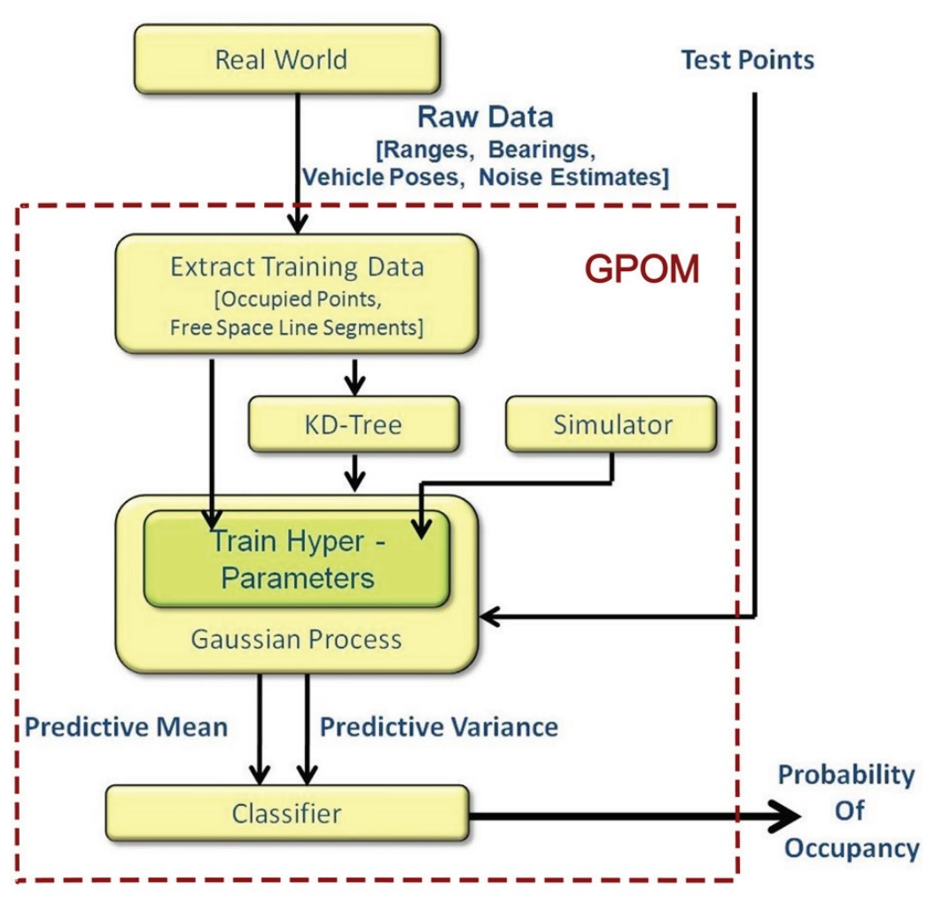
Algorithm

Slide 34
Algorithm
Get input data from world
Notes:
1) We get the sensor data about the environment.

Slide 35
Algorithm
Get input data from world
Collect samples for training GP
Notes:
2) The next step is to collect some training samples to train a GP.

Slide 36
Algorithm
Get input data from world
Collect samples for training GP
Store training data in KD Tree
Notes:
GP requires the inversion of the covariance matrix which has O(n^3) computation complexity. n is the number of training samples.
As points which are close have greater influence on the covariance function compared to those at distance, we can get samples near the test points and make smaller invertible covariance matrix.
This process is done for the training samples.

Slide 37
Algorithm
Get input data from world
Collect samples for training GP
Store training data in KD Tree
Training the hyperparameter, maximizing the log marginal likelihood
P(O|X) = N(X, mean, variance)
Notes:
So now we get the probability of a point in the region to be classified as free space or occupied.
Overall, it’s a online classification learning problem where we locally approximate the function.

Slide 38
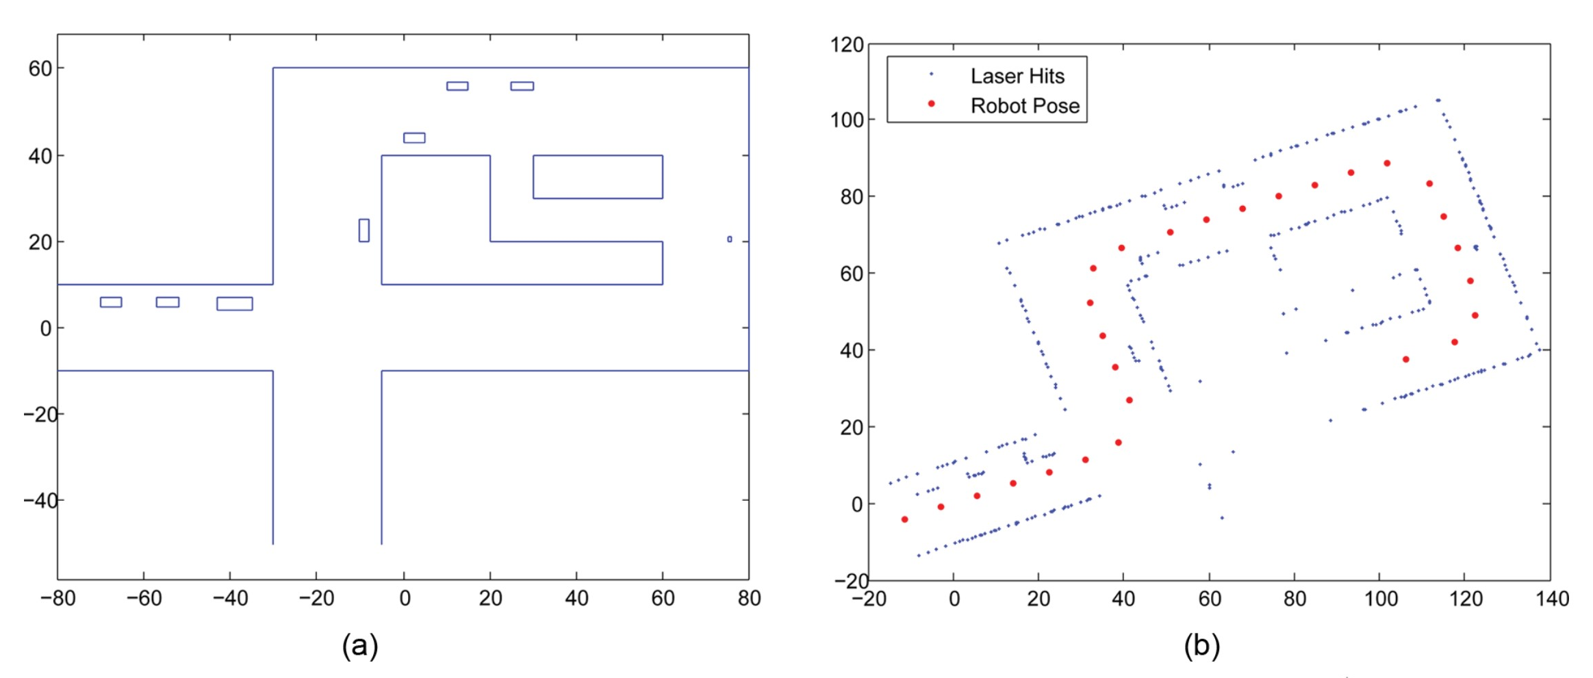
Results
Ground Truth
Laser Return and robot Pose
Notes:
Ground Truth
Laser Return and Robot Pose

Slide 39
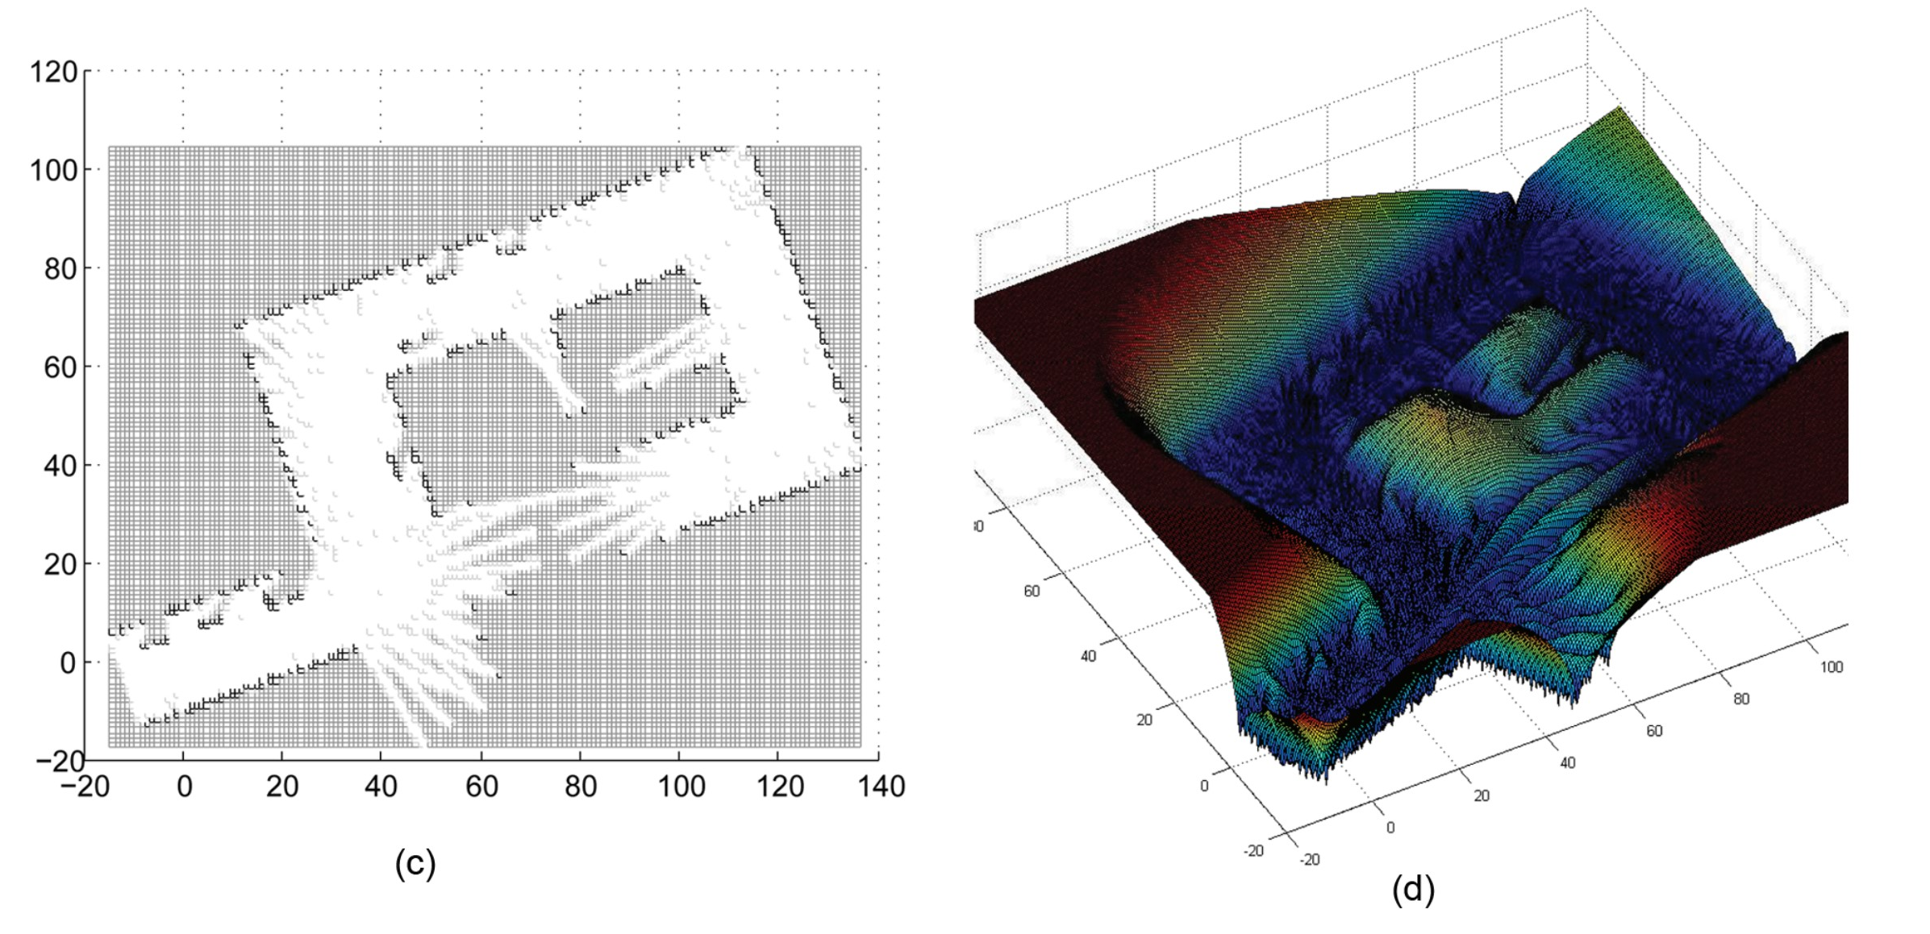
Results
Occupancy Grip
Predicted variance of GP
Notes:
(c) Occupancy Grip
(d) Predicted variance of GP (interestingly very close to repulsion map studied in class)

Slide 40
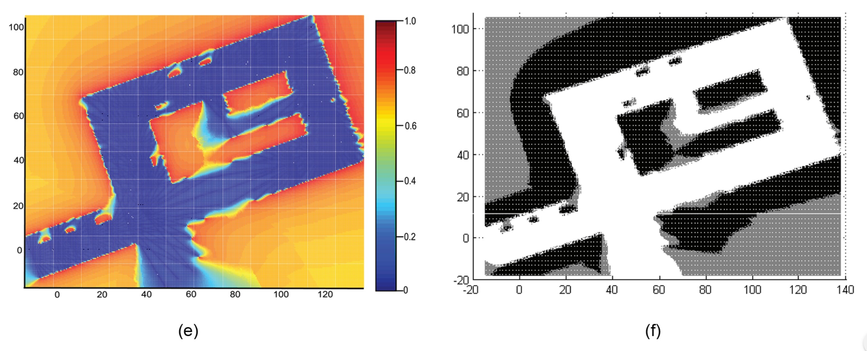
Results
probability of occupancy versus location using the GP approach
classified GPOM
Black = Occupied (p( O | x) ≥ 0.65)
Grey = Unsure ( 0.3 < p( O | x) < 0.7)
White = Free space (p( O | x) ≤ 0.35)
Notes:
(e)This is the result that we get after training the hyperparameters. It shows the probability of a space being occupied.
(f) The figure on the right is the final output of the classification process. Note the grey region is the area that the robot can explore.

Slide 41
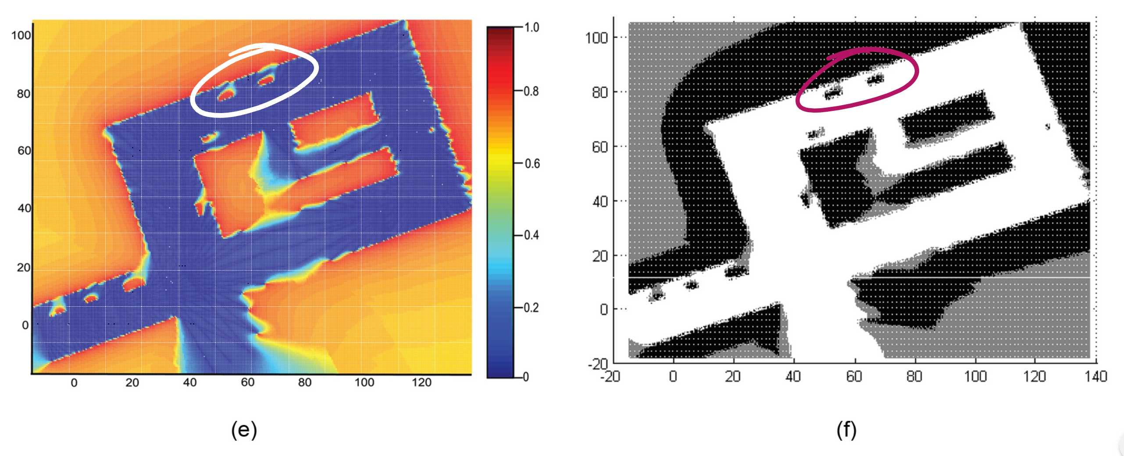

Results
probability of occupancy versus location using the GP approach
Occupancy Grip
Notes:
Comparing the results with naïve occupancy grid map, we can see
in (1) how the occluded area behind the two blocks was unmarked in the occupancy grid (slide 9) is now perfectly classified due to dependency of neighboring cells.
Whereas in (2) the region is correctly predicted as safe path even though the sensor data was not available.

Slide 42


Results
probability of occupancy versus location using the GP approach
Occupancy Grip
Notes:
Comparing the results with naïve occupancy grid map, we can see
in (1) how the occluded area behind the two blocks was unmarked in the occupancy grid (slide 9) is now perfectly classified due to dependency of neighboring cells.
Whereas in (2) the region is correctly predicted as safe path even though the sensor data was not available.

Slide 43
Conclusion
learn dependencies between the points.
Robust to sensor noise and occlusion
Continuous probabilities allow ‘Any-time’ algorithm.
We can achieve arbitrary accuracy in discretization
Provides prediction of occupancy with variance
Useful in identifying the unexplored regions
Works with sparse data
Saves memory and computation time
Notes:
Gaussian process provide several benefits over the naïve occupancy grid map.
1) It can learn the dependencies between the points and thus it is robust to sensor noise and occlusion.
2) As we learn a continuous, non-linear function which becomes more and more accurate with time and training data, it is an anytime algorithm. We can stop the training process to any arbitrary precision.
3) The variance can be used to optimize the path planning algorithm to maximise the robot’s understanding of it’s environment.
4) Because we now it is a regression problem, we can predict the occupancy using few sample points, saving both memory and computation time.

Slide 44
References
O’Callaghan, S. T., & Ramos, F. T. (2012). Gaussian process occupancy maps. The International Journal of Robotics Research, 31(1), 42-62.
https://distill.pub/2019/visual-exploration-gaussian-processes/
2 - Richard Turner, Introduction to Gaussian Processes - https://www.youtube.com/watch?v=Jv25sg-IYHU

Slide 45
Thank You

Slide 46
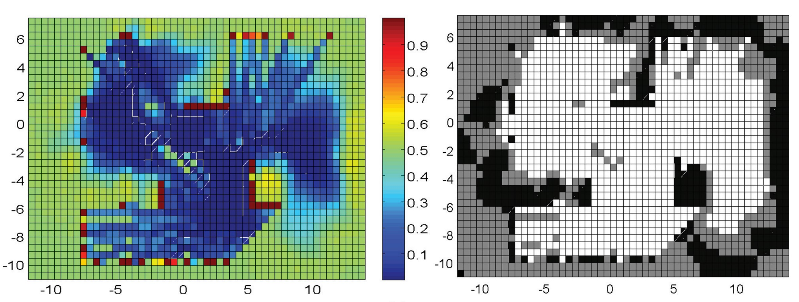
More Results
Occupancy Map
Classified Occupancy Map
Notes:
Probability of occupancy versus location prior to thresholding are shown in the left column. Reddish areas indicate regions with high probability of occupancy while bluish regions suggest the area is most likely free space. (Colour refers to the online version.)
The right column illustrates their corresponding classified maps after applying thresholds. Classification labels: Black = Occupied; White = Unoccupied; Grey = Unsure.

Slide 47
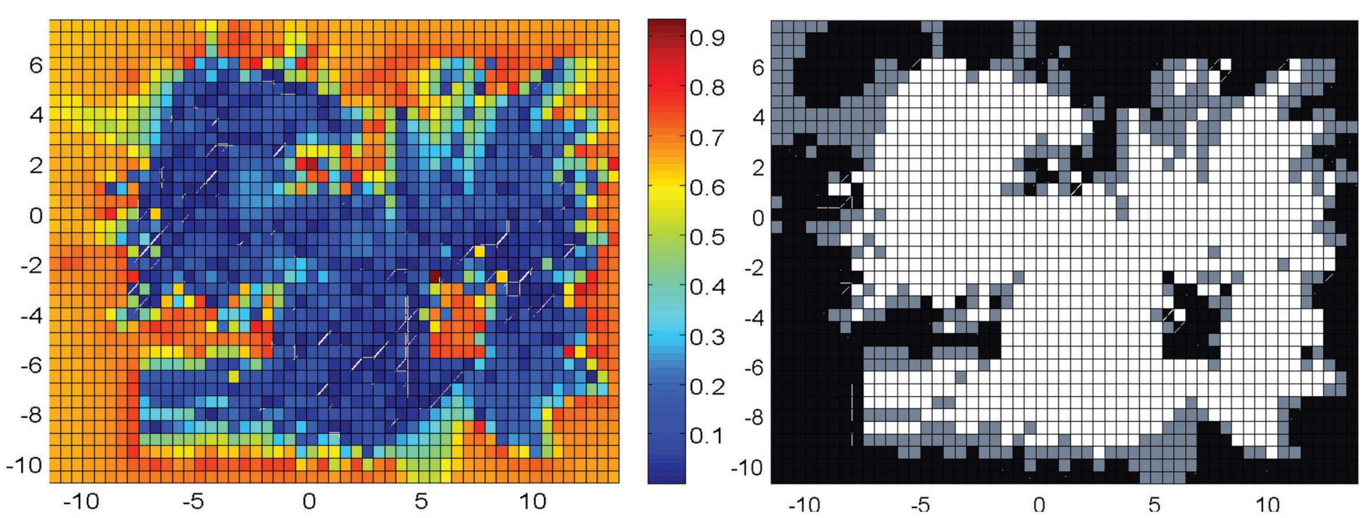
More Results
GPFOL: mapping technique that assumes negligible input noise
Classified GPFOL Map
Notes:
GPFOL: Gaussian Process that assumes Fully observable locations

Slide 48
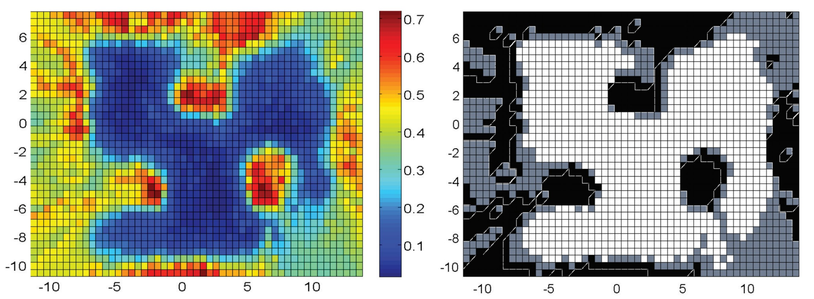
More Results
GPPOL: method which incorporates uncertainty in the observations.
Classified GPPOL Map
Notes:
GPPOL: Gaussian Process that assumes partially observable locations

